Slide 1
In Vivo Raman Spectroscopy of Cancerous Skin Cells
Stephen Esposito (CpE)
Michael Gonzalez (EE)
Chelsea Greene (EE)
Megan Melvin (PSE)
Group 8 CREOL
Notes:
Mike

Slide 2
Live Action Safe Examination Raman Spectrometer - L.A.S.E.R.S.
Advising from Dr. Kyu Young Han
& Dr. Peter J. Delfyett Sponsored by Ocean Optics
Notes:
Mike

Slide 3
Motivation
Cancer is the 2nd leading cause of death in the U.S.
Skin cancer is the most common type of cancer
Skin biopsies:
Invasive, painful, costly
Results may take several days
Pathologist visually inspects biopsy
Notes:
Mike - anecdote

Slide 4
General Specifications
Construct a handheld probe weighing less than 3 lbs (1.4 kg) for comfort and ease of use.
Capture an image of the sample area at least as large as the beam spot size.
Analyse the Raman spectra and discriminate the intensity and wavenumber differences between normal and scarred (or cancerous) skin.
Display results in an easy-to-interpret manner.
Notes:
Mike

Slide 5
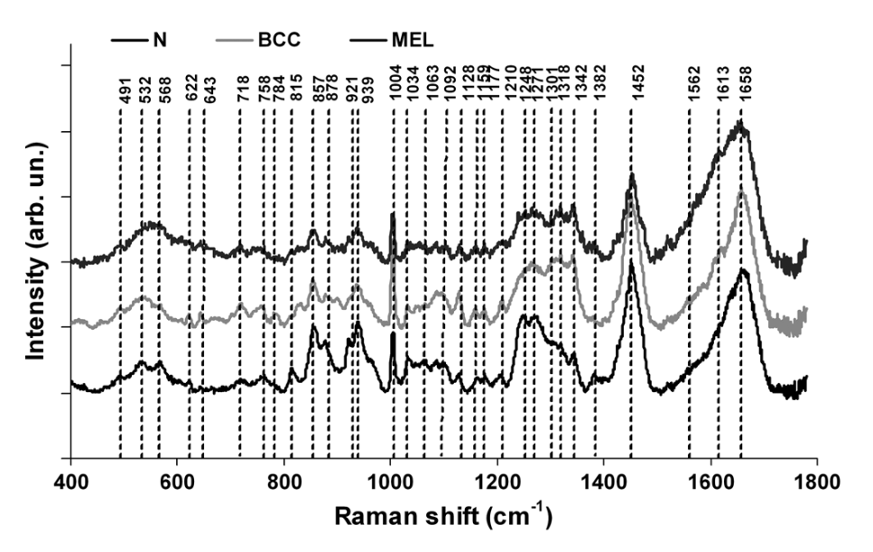
Goals and Objectives
Use Raman spectroscopy to identify cancerous skin cells
Differences in the Raman shift of normal cells versus that of cancerous cells
Benefits of Raman:
Non-invasive
Non-destructive
Fast results
Average normalized spectra of normal skin, basal cell carcinoma, and melanoma, showing differences in relative intensities and peak wavelengths.
[DOI: 10.1117/1.JBO.17.7.077003]
Notes:
Megan
The goal of our project is to identify cancerous skin cells by building a probe and system that will utilize Raman spectroscopy. Raman can tell us what sample is being analyzed based on its unique spectrum. By analyzing the wavelength peaks and intensities of the spectrum, we can differentiate between normal skin and cancerous skin. For instance, the figure on the right shows the Raman spectra of normal skin, basal cell carcinoma, and melanoma. The benefits of this technique are that it is non-invasive (as a laser light is simply shone on the skin), it is non-destructive (as the skin is not damaged in any way), and results can be provided right away.

Slide 6
Optical Specifications
Achieve a narrow laser bandwidth of less than 4.7 nm (65 cm-1) enabling the nearest Raman signal to be acquired (851 nm or 1000 cm-1).
Deliver at least 20 mW of laser power to the sample.
Restrict the temperature increase of the sample to less than 10 degrees Celsius (non-painful).
Collect the Raman signal over a minimum range of 1000 to 1800 cm-1 (851 to 914 nm).
Notes:
Megan
Optical specifications for this probe include: Achieving a narrow laser bandwidth of less than 4.7 nm to enable the nearest Raman signal of interest to be acquired, which is at 851 nm. Delivering at least 20 mW of laser power to the sample in order to generate a strong Raman signal. Restricting the temperature increase at the sample to less than 10 degrees so that the laser beam is non-painful. Collecting the Raman signal over a minimum range of 1000 to 1800 wavenumbers to include the three of the most prominent signal bands of skin, which relate to the amide proteins and collagen in skin. (Can go back 1 slide to point out the wavenumber range on the figure.)

Slide 7
Computer and Electrical Specifications
Power to component +/- 5% of ideal rated value
No more than 15 V within the device
Minimum 5 megapixel camera
System temperature below 142℉/60.6℃
Cannot permanently attach donated parts
Data sampling and compiling time must be under 5 minutes
Exposure time to sample less than 30 seconds
User interface can run on various on market devices
Modular design to ease troubleshooting
Notes:
Chelsea

Slide 8
Requirements
Follow all necessary standards
Reliable, effective, ergonomic
Logical with time and economic constraints
Safe, no risk to patient or user
Fit in typical office environment
Cost effective for user
Notes:
Chelsea

Slide 9
Sponsor Requirements
Improve an on-market device
Add value to a product, increase marketability
Improve the user experience
Specific for target market
Improve visibility of sample scanned with camera and light
Notes:
Stephen

Slide 10
Design
Notes:
Megan
Now we’ll jump into the design of the project, which will cover our responsibilities and how the electrical, computer, and optical areas work together.

Slide 11
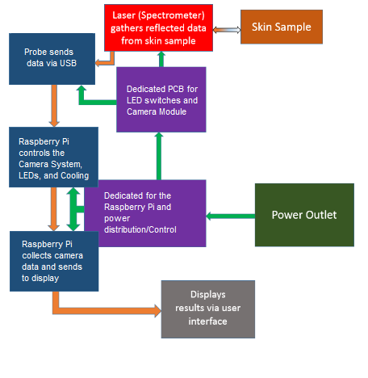
Data
and
Power
Flow
Notes:
Megan - laser and skin sample, spectrometer - The probe directly interacts with the skin to be sampled. Via the probe, a camera captures an image of the sample area, the laser power is delivered to the sample, and the Raman signal is collected and delivered to the spectrometer.
Stephen - control and data flow
Chelsea and Mike - electrical

Slide 12
Responsibilities
Responsibility | Stephen Esposito | Michael Gonzalez | Chelsea Greene | Megan Melvin
Physical Design |  | Primary |  | Secondary
Probe PCB |  | Primary | Primary
Power PCB |  | Secondary | Primary
Data Analysis | Primary |  |  | Secondary
User Interface | Primary |  | Secondary
Optics | Secondary |  |  | Primary
Laser Safety |  |  | Secondary | Primary
Notes:
Stephen, Mike, Chelsea, Megan - In order by column, introduce your primary responsibilities.
We’re all in this together :’)
Megan - My primary roles include the optics within the probe and laser safety for both user and patient.

Slide 13
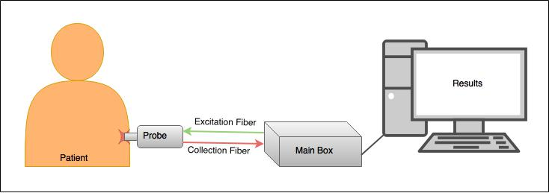
Overall Systemic View
Notes:
Megan
This diagram shows the big picture of our project. The Main Box contains the laser, spectrometer, PCB, and Raspberry Pi. The laser power is delivered via the excitation optical fiber to the probe and to the sample. The collected Raman signal is delivered to the spectrometer through the collection fiber. The camera within the probe captures an image of the sample area. The PCB powers the camera and laser, while the Raspberry Pi controls the components and data transfer. The Raman and image data are transferred to a computer where the results will be displayed.

Slide 14
Safety
Personal Protective Equipment (PPE): Laser safety glasses
Engineering controls: Protective housing
Laser activation warning
Output power controlled
Administrative & Procedural controls: Proper labelling
Product user manual
Notes:
Megan
Control measures for the safety of the user and the patient:
-PPE: laser safety glasses to protect against eye damage from laser (NIR capable of causing cataracts and retinal burns). However because the laser is enclosed when properly used, safety glasses are unnecessary.
-”Engineering controls are normally designed and built into the laser equipment to provide for safety.”: Protective housing from probe design and optical fibers (enclosed beam), & laser activation warning (LED indicating laser is firing), & output power and firing time are not enough for thermal damage to skin
-Admin & procedural controls: proper labelling of laser class and components of product, product literature such as a user manual
https://www.osha.gov/dts/osta/otm/otm_iii/otm_iii_6.html

Slide 15
Main Body
Notes:
Mike

Slide 16
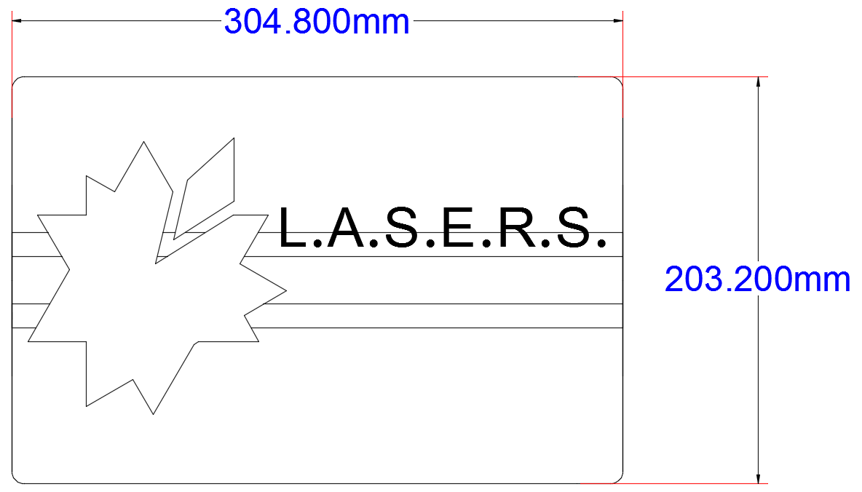
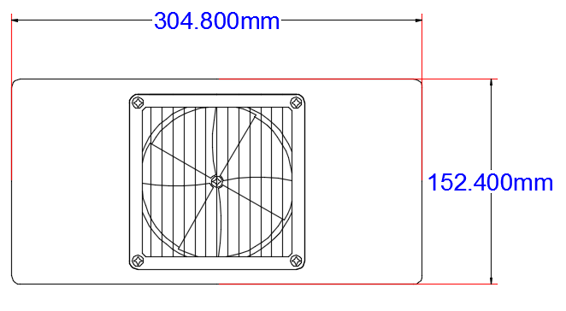
Encasing Design and Structure
Top View
Side View
Notes:
Mike

Slide 17
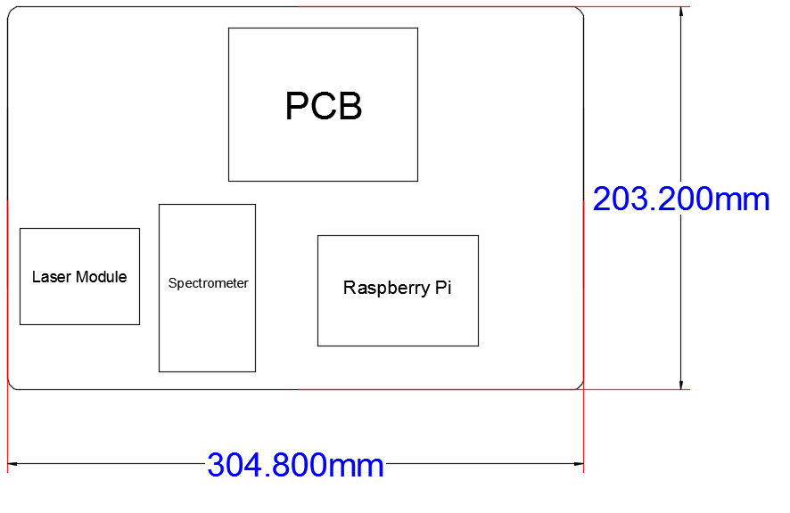
Interior View
Notes:
Mike

Slide 18
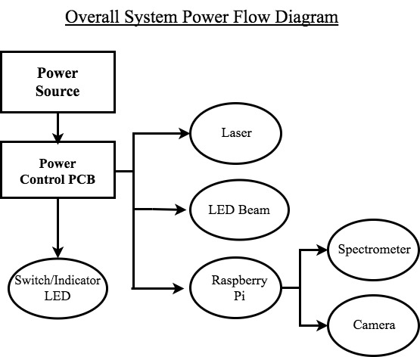
Power Control
Part Name | Minimum Power Required
Laser (785-IP-02-1208) | 3.5 W
Raspberry Pi | 2.5 W
Camera Module | 1.75 W
LEDs (Red and White) | 0.036 W
Spectrometer | 1.25 W
Notes:
Chelsea

Slide 19
Additional Electronics Elements
Power to laser indicator LED
Safety switch
Screen (in probe)
Camera (in probe)
LED beam (in probe)
Notes:
Chelsea

Slide 20
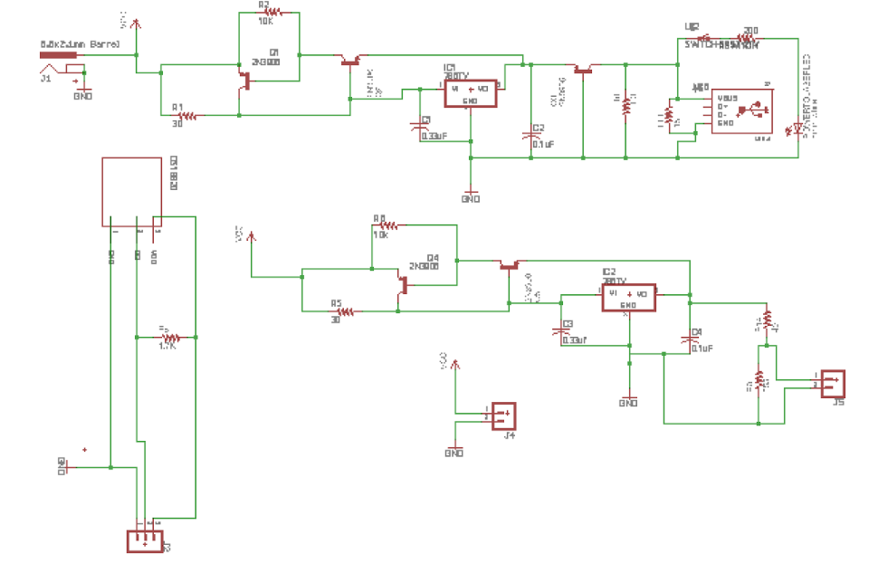
Notes:
Chelsea

Slide 23
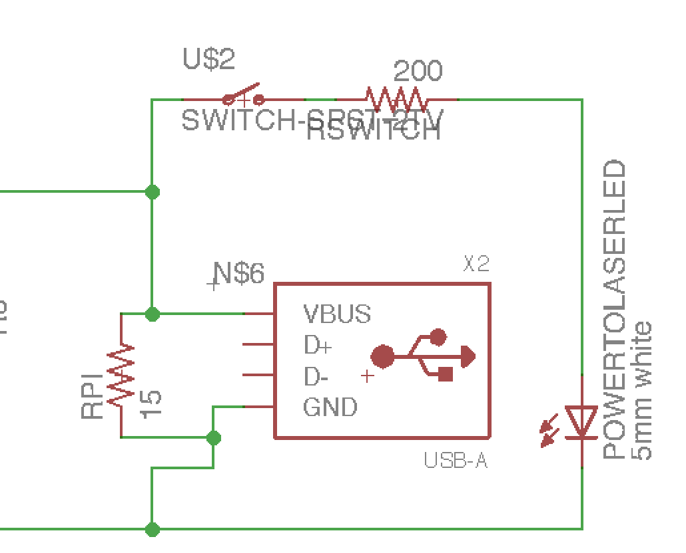
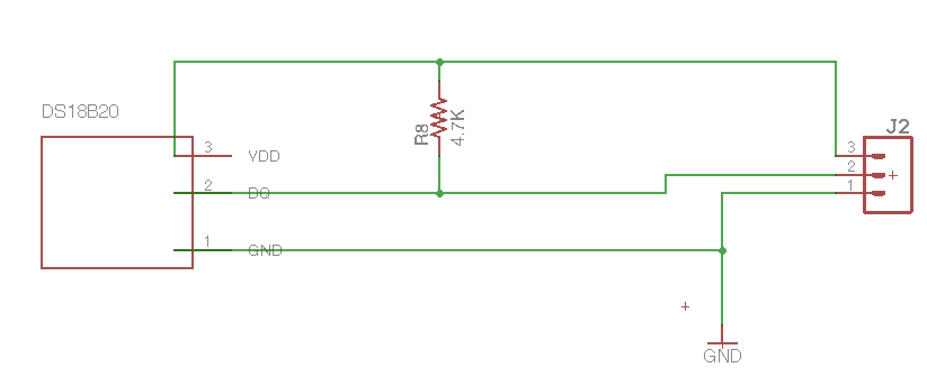
Notes:
Mike

Slide 24
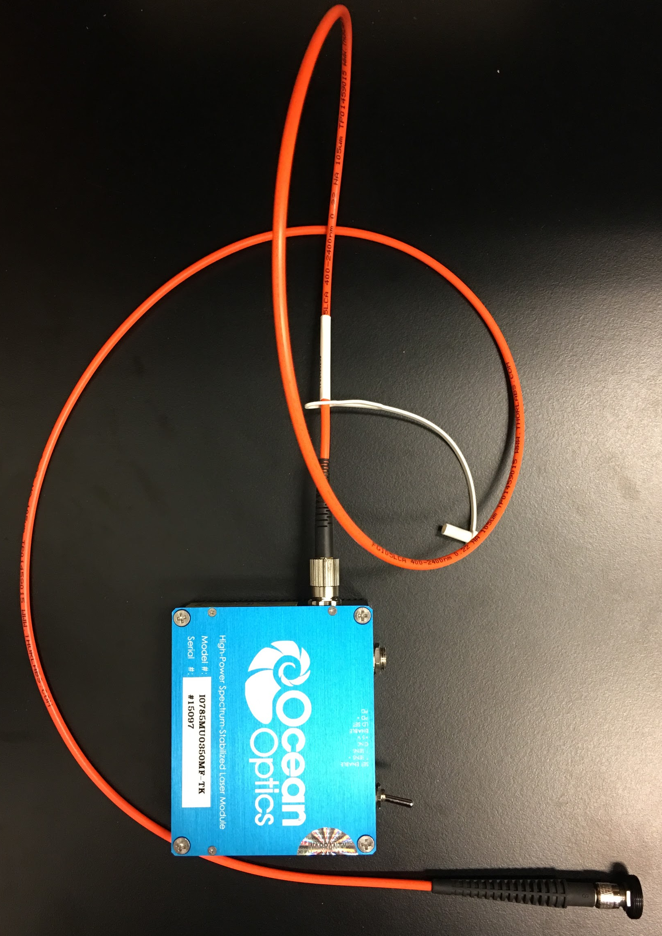
Laser
1 m Fiber
High-Power > 350 mW
Spectrum-Stabilized
Near-infrared 785 nm excitation wavelength
Class IIIb (Class I if enclosed)
Delivers laser light to probe via optical fiber
6.4 cm
7.6 cm
Notes:
Megan
-High power: produce substantial signal from sample
-Spectrum stabilized: prevent mode hopping, get high resolution
-NIR: prevent autofluorescence of sample
-Hazard Class 3b: can cause serious damage to the eye, at high powers may lightly burn skin and other materials, presenting a fire hazard

Slide 25
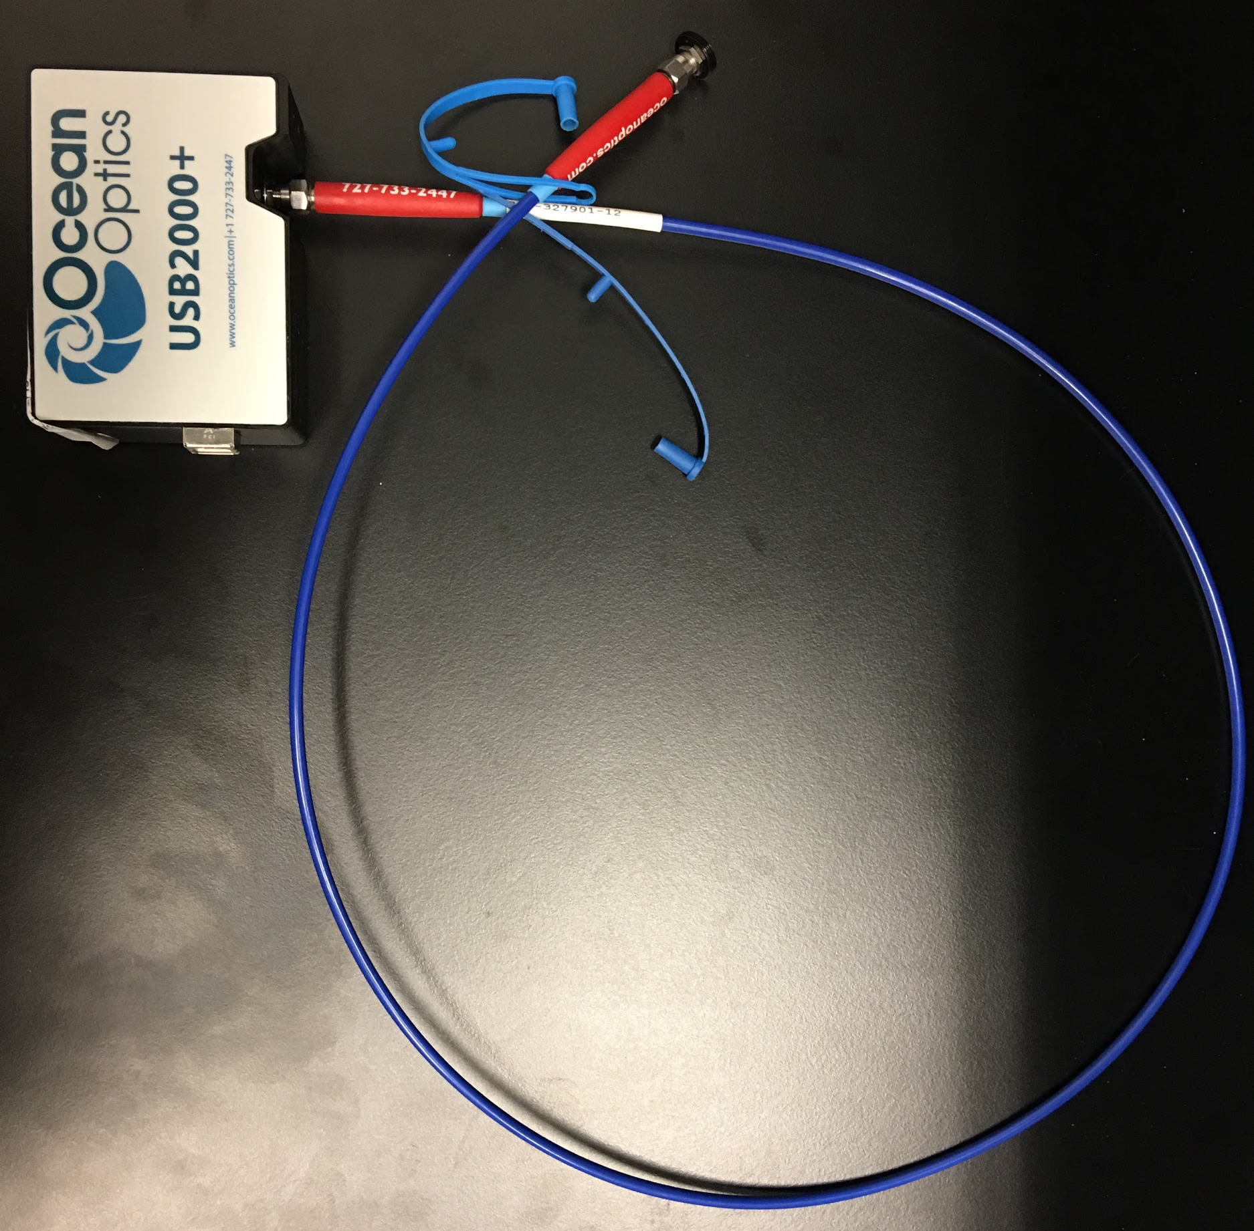
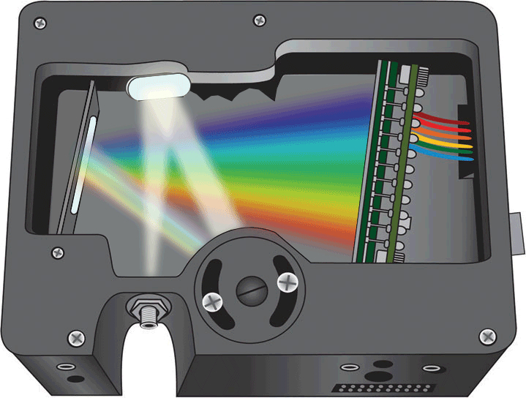
Spectrometer
8.91 cm
Ocean Optics USB2000+
High resolution, high SNR
Raman signal from probe is delivered
to spectrometer via optical fiber
6.33 cm
1 m Fiber
Notes:
Megan
-USB2000+ spectrometer provided by Ocean Optics
-Used to record the Raman spectrum of the sample
-High resolution & high signal-to-noise ratio for best Raman spectrum

Slide 26
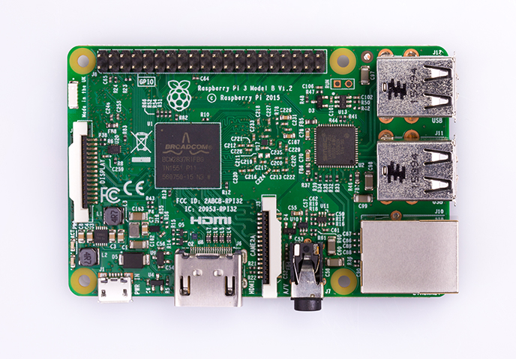
Raspberry Pi 3
85 mm
Important Specifications:
1.2GHz quad-core ARMv8 Processor
1GB Ram
40 GPIO Pins
4 USB Ports
HDMI Port
56 mm
Notes:
Stephen

Slide 27
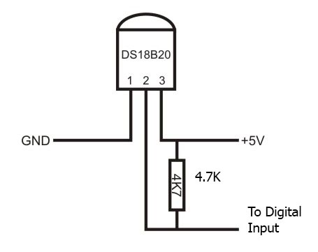
Heat Concerns: Main Body
System Instability- Laser and Microcontroller
User safety
Addressed with:
Temperature Sensor (Dallas DS18B20)
Heat Sinks
Fan
Notes:
Stephen

Slide 28
Probe
Notes:
Megan
Now we’ll discuss the probe specifically.

Slide 29
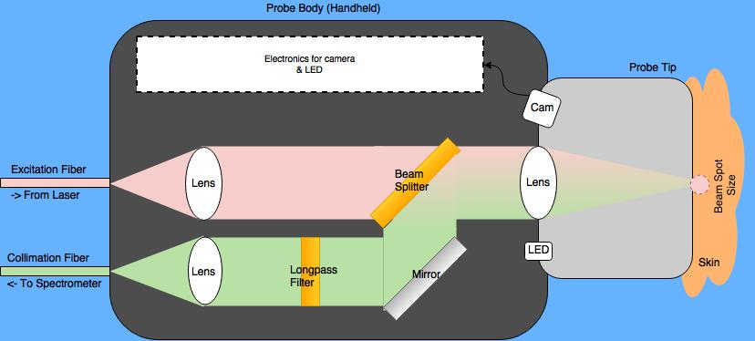
Probe Concept
Notes:
Megan
Here is a diagram of our probe concept so we can easily explain the inner workings. The probe body is designed to be handheld. Within the probe are the electronics for the camera module and LED, as well as the optical components. The LED provides illumination for the camera to capture an image of the sample area. The laser power from the excitation fiber is collimated by a lens before being transmitted through a beam splitter and a second lens, where the laser power is focused to a beam spot size of less than a few millimeters onto the skin. The reflected Raman signal from the skin is collected by the same lens, where it is then collimated and redirected by the beam splitter and mirror to a longpass filter. The signal is then coupled into the collimation fiber by a lens, and is delivered to the spectrometer.

Slide 30
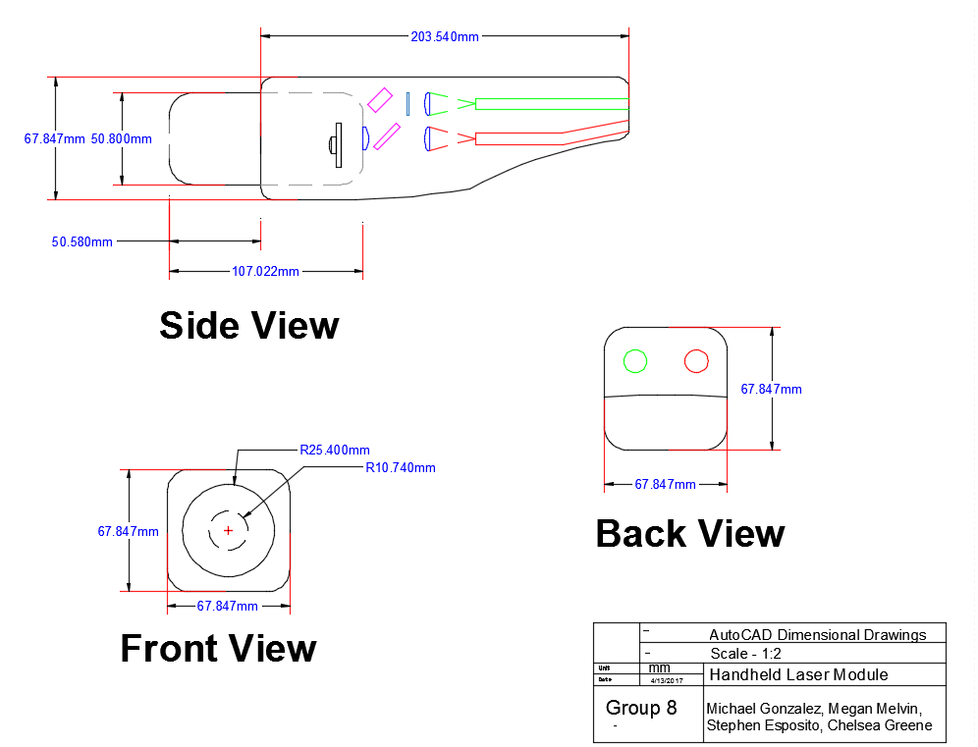
Notes:
Mike

Slide 31
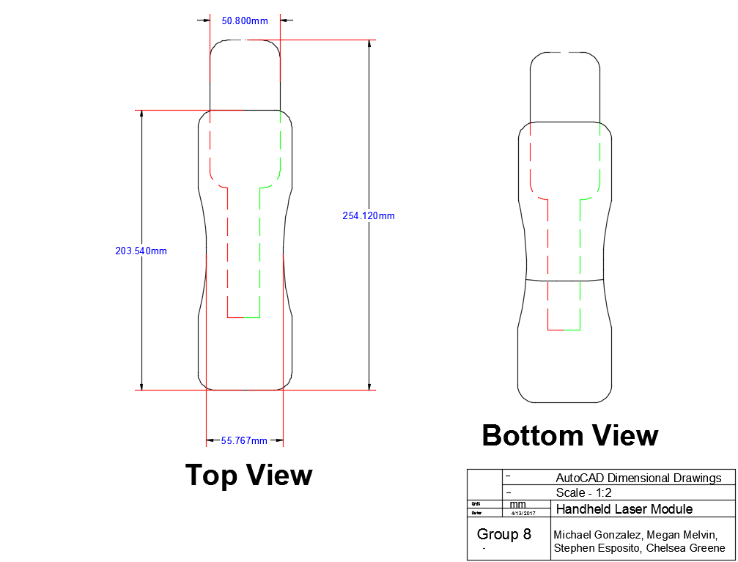
Notes:
Mike

Slide 32
Probe Dimensions
Measured Distance | Dimensions (mm) | Dimensions (in)
Encasing Length (L) | 203.540 | 8.013
Encasing Ranged Width (W) | 34.570 to 67.847 | 1.361 to 2.671
Encasing Ranged Depth (D) | 55.787 to 67.847 | 2.196 to 2.671
Probe Overall Length (L) | 107.022 | 4.213
Probe Protruded Length (L) | 50.580 | 1.991
Probe Radius (R) | 25.400 | 1.000
Probe Inner Radius (R) | 10.740 | 0.423
Notes:
Mike

Slide 33
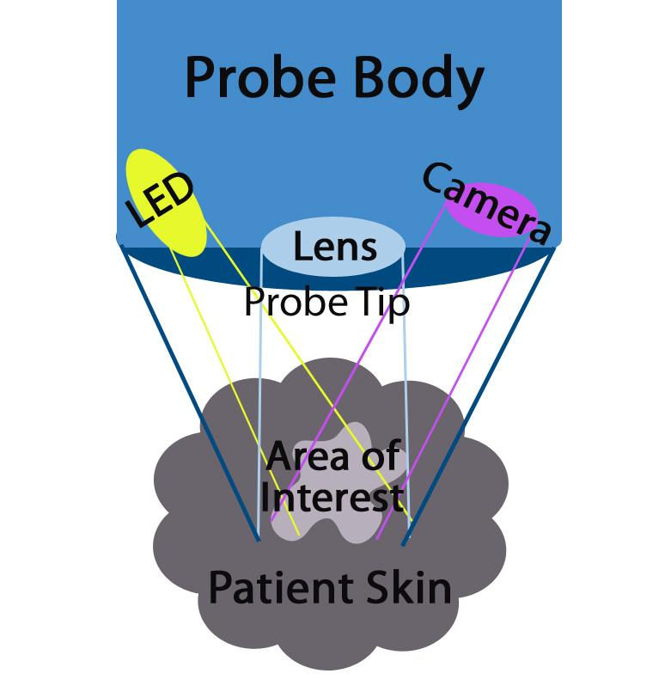
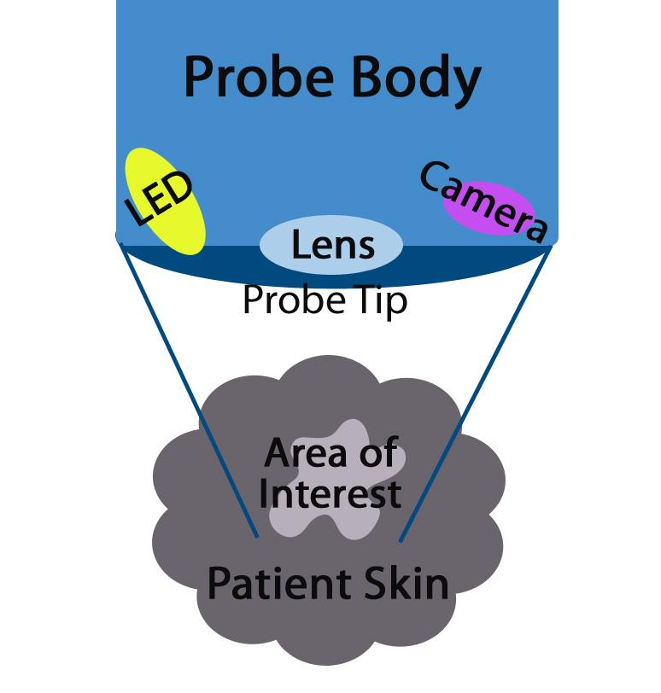
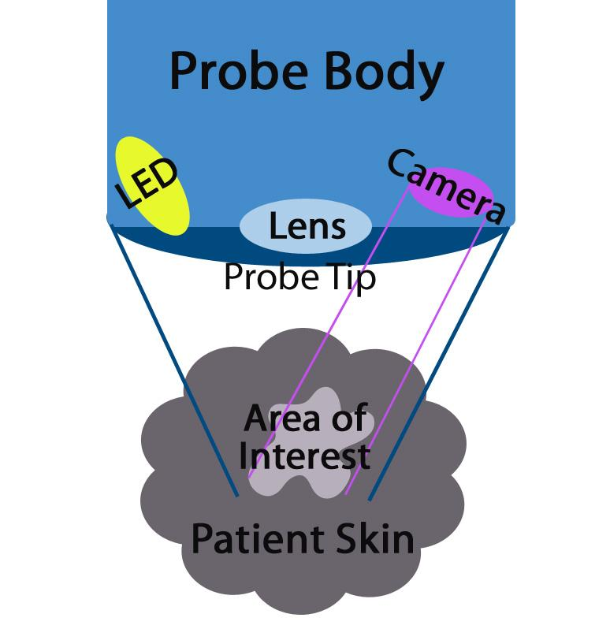
Notes:
Chelsea

Slide 34
Comparison of Camera Modules
Brand | Specific Product | Price Range | Megapixels
Adafruit | Raspberry Pi Camera Module V2 | $29.89 | 8.0
Arducam | OV5647 Mini Camera Module for Raspberry Pi | $14.99 | 5.0
SainSmart | Camera Module Board Webcam Video for Raspberry Pi 3 | $13.99 | 5.0
Notes:
Functionality outweighs price
Chelsea

Slide 35
Camera
25 mm
Allows for imaging and visibility of sample
High resolution, small, effective with changes in light
Allow real-time video feedback of skin sample
Allow for photographing the tested skin sample
Easy to interface with microcontroller
White LED illuminates skin/sample
24 mm
16 mm
Notes:
Chelsea

Slide 36
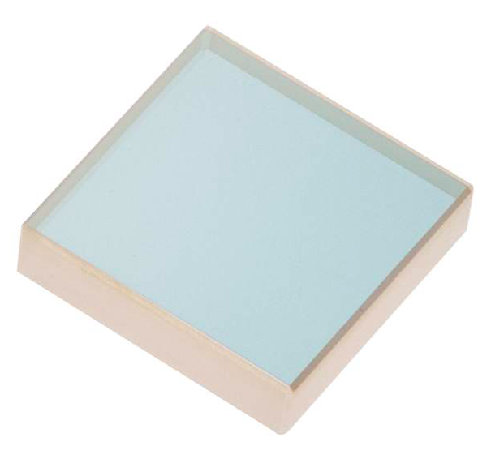
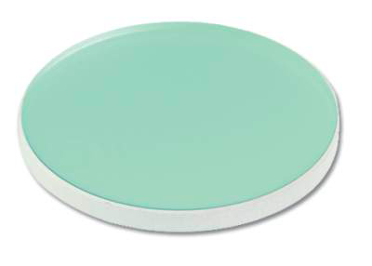
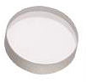
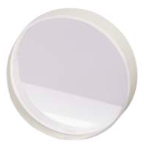
Optics
12.7 mm
19.05 mm
Optical fibers for NIR transmission
AR coated plano-CX lenses for collimation and focusing
Beamsplitter to decrease incident power, redirect Raman signal
Mirror
Longpass filter to diminish Rayleigh signal (785 nm), allow transmission of Raman signal ( > 800 nm)
Longpass Filter
Mirror
6.35 mm
25.4 mm
(1“)
Lens
Beamsplitter
Notes:
Megan
-Deliver laser excitation from laser source to probe
-Deliver collected Raman signal from probe to spectrometer
-3 anti-reflection coated plano-CX lenses, Numerical aperture of 0.22: 1 lens to collimate light from the excitation fiber, 1 lens to focus collimated light onto sample, and 1 lens to focus the Raman signal into collection fiber.
-1 Beamsplitter: 50/50 (R/T) coating, to decrease incident laser power and redirect the Raman signal.
-1 Mirror to direct light through probe
-1 Longpass filter: reduce the intensity of the laser signal (785 nm) to allow the Raman signal (> 800 nm) to be detectable
If you notice the dimensions of the optical components, they are all 1 inch or smaller. This keeps the probe compact so it can be handheld.

Slide 37
Mounting the Optics Within the Probe
Optics within the probe must be well-aligned and sturdy.
3D printed mounts allow for custom-sized optical holders.
Can print individual holders and/or as a channel for the rays to travel through. Use optical glue and/or set screws.
Notes:
Megan & Mike
Well-aligned for light rays to propagate through optics for maximum power and signal.
Sturdy because the probe is handheld and movable.
For mounting the optical components within the probe:
-3D printed mounts: open source designs available online
-Talk about constraints: space for optics and electronics, fiber connections to prevent bending

Slide 38
Data Collection and Analysis
Notes:
Stephen

Slide 39
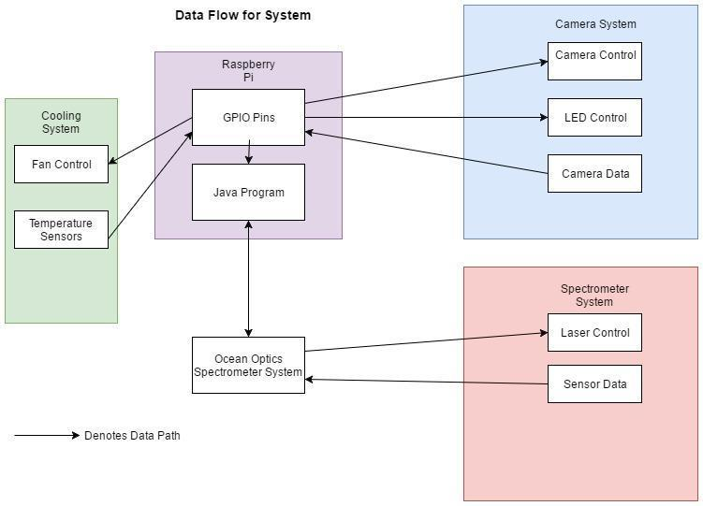
Notes:
Stephen

Slide 40
System Control
Control Program
Java-based backend
Omni Driver Java API - Spectrometer Control
Pi4J Library - GPIO Pin Control
Control Ports
Spectrometer - USB Port
Laser- GPIO Pin
Temperature Sensor- GPIO Pin
Camera System- CS Interface
Fan System- GPIO Pins
Notes:
Stephen

Slide 41
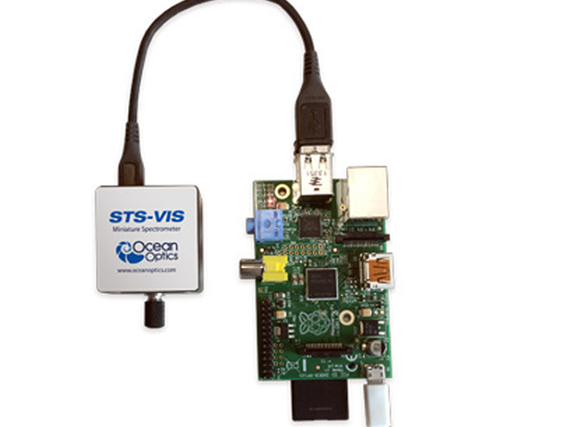
OmniDriver
Ocean Optic’s Driver for all USB spectrometers
Cross Platform- Java, C#, Visual Basic, etc.
Allows us to create own intuitive backend program to control spectrometer
Due to the cross-platform nature, this program should be able to be controlled via the 15 billion java devices
Notes:
Stephen

Slide 42
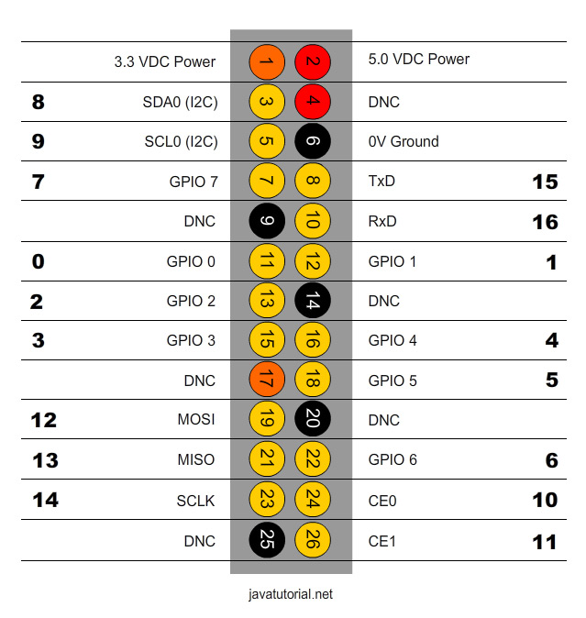
Pi4J
Open Source Project
Low Level I/O Library
Object-Oriented API
Event Based
GPIO Pin control
Notes:
Stephen

Slide 43
Data Analysis
Dark Spectrum Analysis-
Use Spectrometer to analyze raman signal without laser input
Run 20 Times to reduce impact of outlier results
~5s Runtime
Laser Spectrum Analysis-
Use Laser/Spectrometer System to Analyze Skin Sample
Run 100 Times to reduce impact of outlier results
~30s Runtime
Laser Spectrum Analysis ( 100 Pass Average)
Dark Spectrum Analysis (100 Pass Average)
Laser Spectrum - Dark Spectrum
Remove Nonlinearity
Apply Smoothing
Return Results
Ensemble Average Smoothing-
Run over all 100 data passes
Reduces SNR by factor of 10-fold on 100 pases
Notes:
Stephen

Slide 44
User Interface
Notes:
Stephen

Slide 45
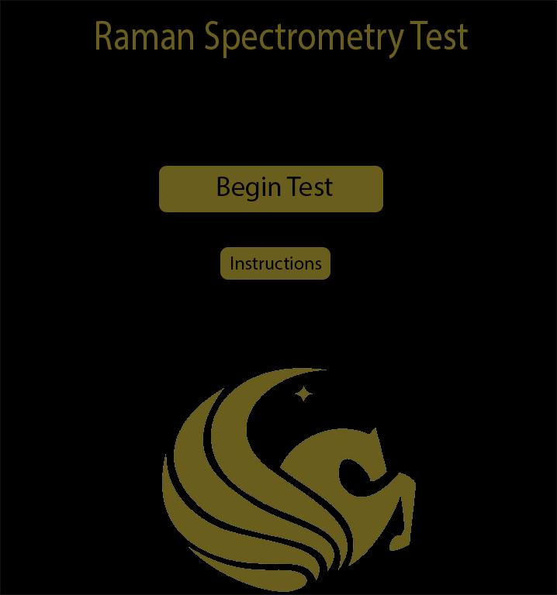
User Interface
Visual representation of the project to end-users
Specifications:
Intuitive
Professional
Minimalistic
Notes:
Stephen

Slide 46
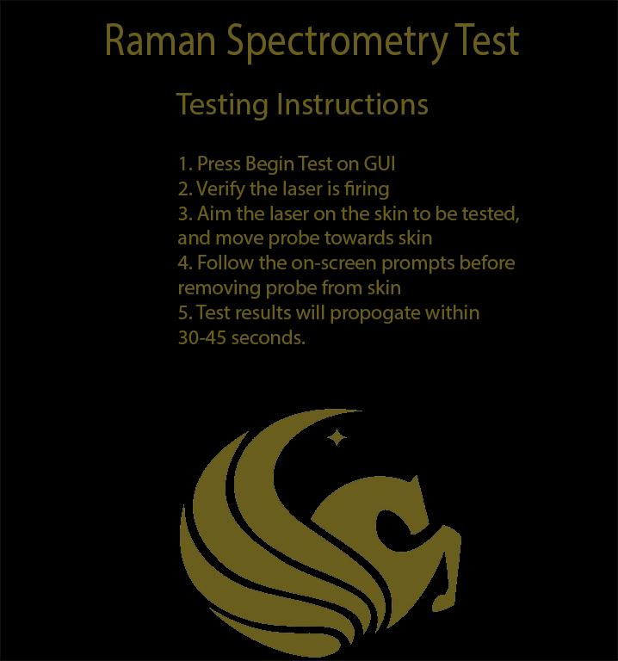
Notes:
Stephen

Slide 47
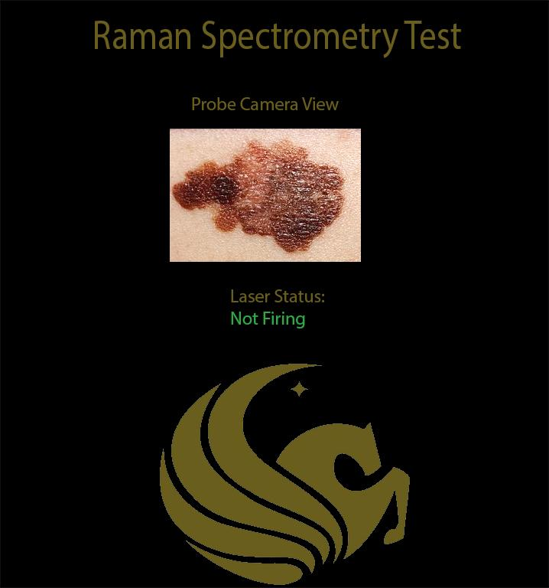
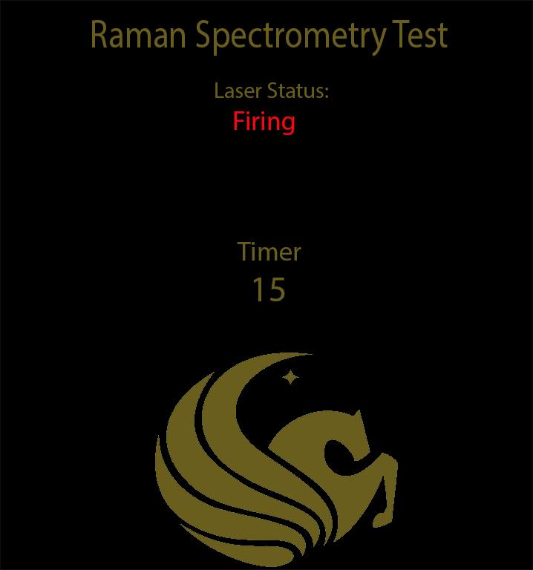
Notes:
Stephen

Slide 48
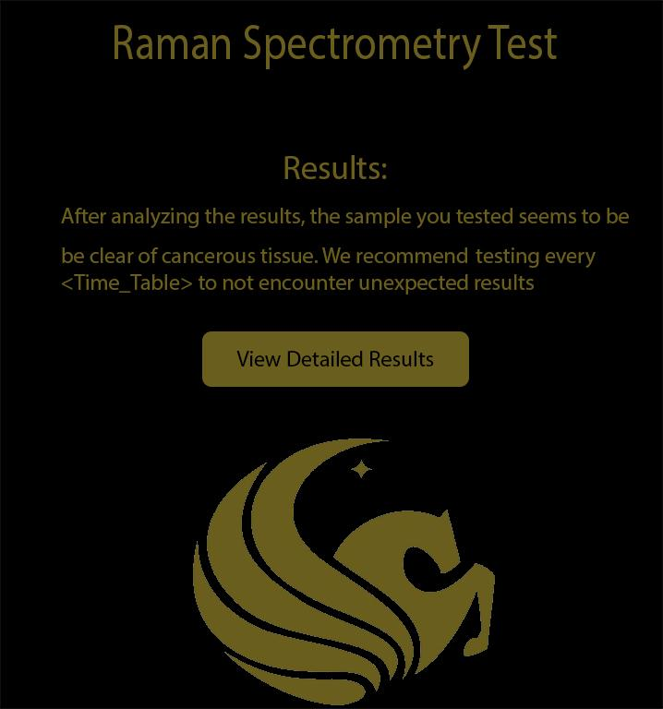
Notes:
Stephen

Slide 49
Budget and Financing
Notes:
Mike

Slide 50
Budget Goal
Cost effective: < $1,500.00
Sponsorship from Ocean Optics
Donations from CREOL
Current cost total: $341.12
Notes:
Mike
Cost effective compared to multiple biopsies: under $1,500.00
Sponsorship improves direction and reduces costs: Ocean Optics
Current cost total:
Optics are expen$$$$$$ive!
CREOL department assisting with mount cost

Slide 51
Current Expenses
Item | Specific Model | Manufacturer | Qty | Cost per Item
PCB A | - | OSH Park | 1 | $41.33
PCB B | - | OSH Park | 1 | $35.82
Switch | Rocker Switch-SPST | Sparkfun | 1 | $0.95
Fiber Optic Cable | M18L01 | Thorlabs | 1 | $75.75
Fiber Adaptor Plates | SM05SMA | Thorlabs | 2 | $28.00
Longpass Filter | 5CGA-800 | Newport | 1 | $15.00
Microcontroller | Raspberry Pi 3 Model B | Raspberry Pi | 1 | $35.00
Notes:
Mike

Slide 52
Item | Specific Model | Manufacturer | Qty | Cost per Item
Temperature Sensor | DS18B20+ | Maxim Integrated | 1 | $6.50
CMOS Camera | Raspberry Pi Camera Module V2 | Adafruit | 1 | $29.89
Wall Adapter Charger Power Supply | 12V DC 2A | NorthPada | 1 | $8.99
9 V Voltage Regulator | LM7809 | Parts Express | 2 | $3.92
Flex Cable | ADA2144 | Adafruit | 1 | $12.49
Additional Cables, Ports |  |  |  | $2.61
Additional Electronics | LEDs, transistors, etc. |  |  | $12.96
TOTAL |  |  |  | $341.12
Notes:
Fan Various cables Additional integrated circuits, if needed
PCB B
Casing shell and ergonomic add-ons

Slide 53
Non-incurred Expenses
Item | Specific Model | Manufacturer | Qty | MSRP
Multimode Spectrum Stabilized Laser Subsystem (785 nm) | LASER-785-IP-02-1208 | Ocean Optics | 1 | $8,333.00
Spectrometer | USB2000+VIS | Ocean Optics | 1
Probe |  | InPhotonics | 1
Lenses | KPX019AR.16 | Newport | 3 | $63.00 ea
Mirror | 07SD520BD.2 | Newport | 1 | $55.00
Fiber Optic Cable |  | Ocean Optics | 1
Beamsplitter | 10Q40BS.2 | Newport | 1 | $266.00
Notes:
Mike

Slide 54
Progress
Notes:
Chelsea

Slide 55
Major Goals Completed
Milestone | Milestone Date
Sponsor Acquired | March 2017
Major Parts Acquired | April-May 2017
120 Page Final Document | 04/27/2017
Finalize Optics Dimensions, Design Optical Mounts within Probe | May 2017
GUI Prototype | May 2017
Optical Layout Verified | June 2017
Main PCB Sent Out | June 7th
Basic System Control Established | June 11th
Notes:
Chelsea

Slide 56
Major Goals to be Completed
3D print casing
Solder parts on PCBs
Build and connect
Test basic overall functionality
Improve system
Notes:
Chelsea

Slide 57
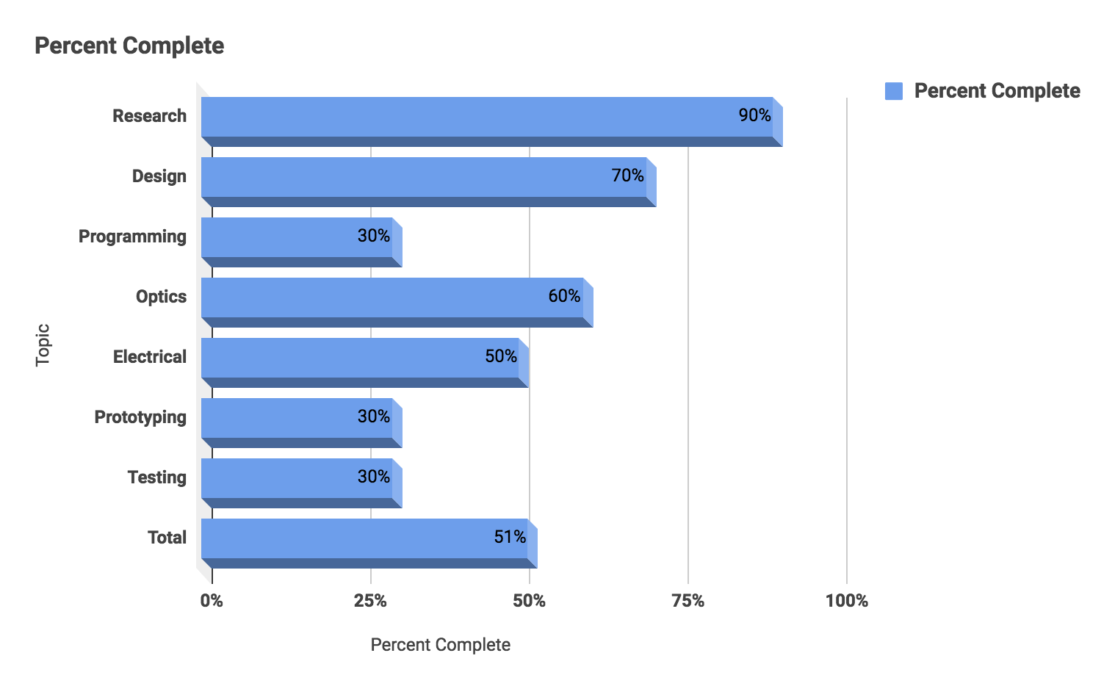
Progress
Notes:
Chelsea

Slide 58
Timeline for Completion
Milestone | Milestone Goal
Solder PCBs | Late June 2017
Order/3D Print Casing | Late June 2017
Build! | Early July 2017
Integrate System | Early July 2017
Test “Final” Setup | July 2017
Perfect | July 2017

Slide 59
Questions?

